Slide 1


Market Basket Analysis for Understanding Customer Purchase Behaviour
BDM
CAPSTONE PROJECT
PRESENTATION
Indian Institute Of Technology, Madras , Chennai , 600036
Sumit Kumar Jena
23f2002871@ds.study.iitm.ac.in

Slide 2
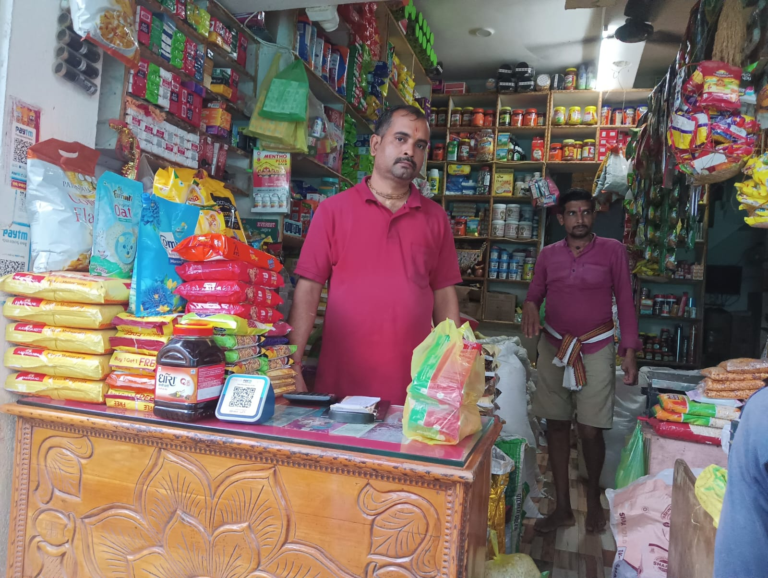
ABOUT THE BUSINESS
  Nana Grocery Store is a neighborhood retail grocery outlet located in Balasore, Odisha, serving the daily household needs of local families.
  The store primarily operates in a B2C model, offering essential grocery items such as staples, beverages, home care, and personal care products through frequent low-value transactions.
  The business is owner-managed and operates with steady customer footfall, but earlier relied mainly on intuition rather than data-driven decision-making.

Slide 3
CHALLENGES
Lack of a structured
understanding of customer
purchase behavior and buying patterns.
Unclear contribution of
product categories and
individual items to
overall revenue.
AbsencinNo structured understanding of customer purchase behavior.ancial knowledge about the business such as Monthly Turnover
Inventory planning and
promotional decisions were
largely intuition-driven,
leading to inefficiencies.
Absence of insights into
products frequently purchased together, limiting cross-selling opportunities.
Lack of Structured
Credit Practices
.

Slide 4
DATA
OVERVIEW
Transaction Data
  Transaction ID
  Date
  Time
  Product Name
  Category
  Quantity
  Unit Price
  Total Price
  Time in Hours
01.
To address the identified challenges, transactional sales data was collected from Nana Grocery Store for a period of three months (August 2025 to October 2025).
The dataset captures real billing-level purchase information required to analyze sales trends and customer buying behavior.
The data was cleaned by standardizing product and category names, removing duplicates, recalculating total prices, validating outliers, and engineering time-based features for analysis.
02.
Sales Summary
  Product Name
  Category
  Total Quantity Sold
  Total Sales Value
  No. of Transactions
  Avg Sales Value

Slide 5
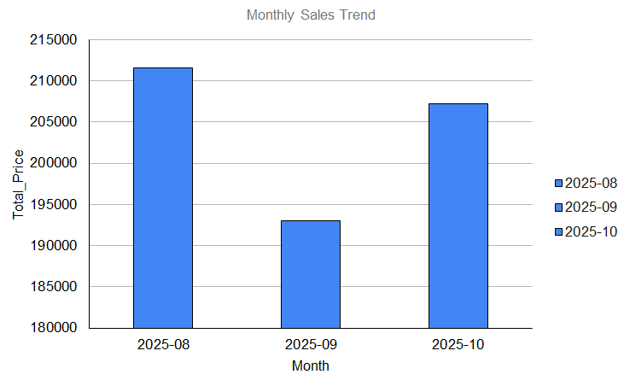
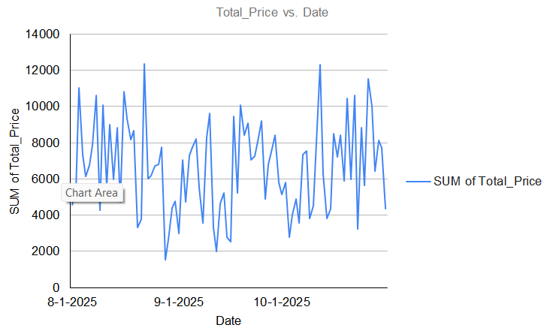
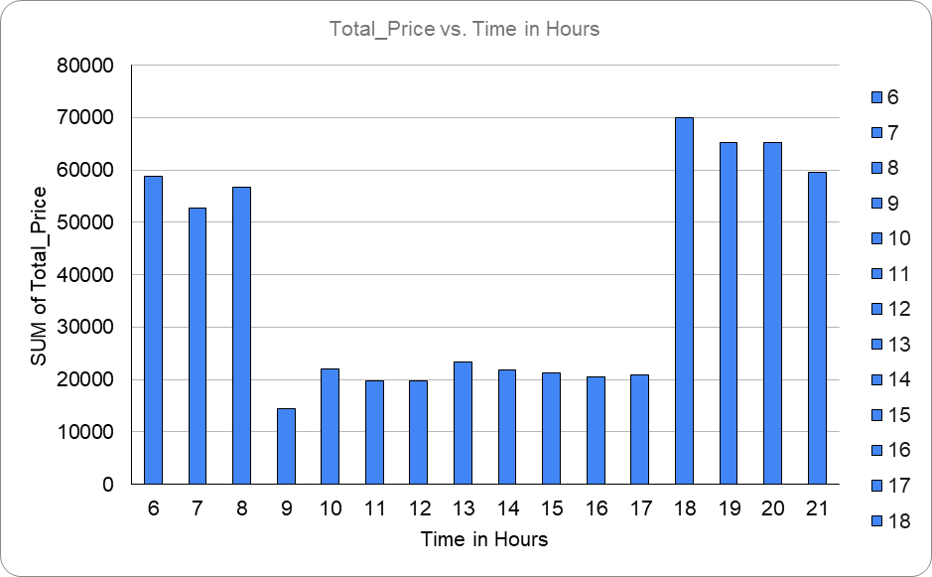
KEY INSIGHTS AND RECOMANDATIONS
Insight : Sales show a predictable
seasonal dip-recovery pattern,
indicating stable demand that
requires advance inventory planning.
Recommendation : Increase stock and promotions before August and October peaks and optimize inventory during September.
Insight : Daily sales fluctuate within a
stable range, indicating demand
variability rather than declining
customer interest.
Recommendation : Strengthen staffing on high-sales days and introduce weekday micro-promotions to lift slow days.
Insight : Sales peak in the morning
and evening, showing time-driven,
habitual customer shopping behavior.
Recommendation : Ensure full stock availability and faster checkout during peak hours and schedule restocking in afternoons.

Slide 6
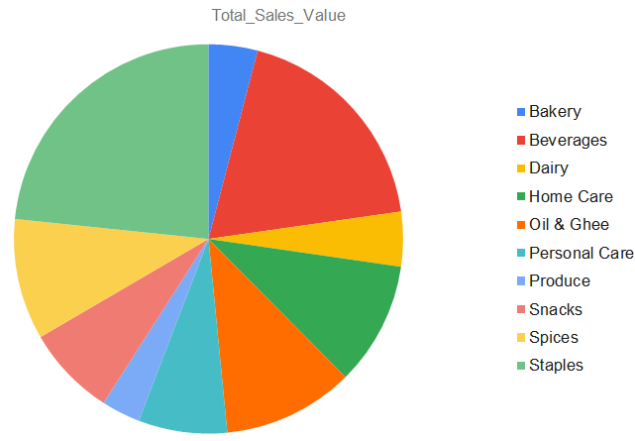
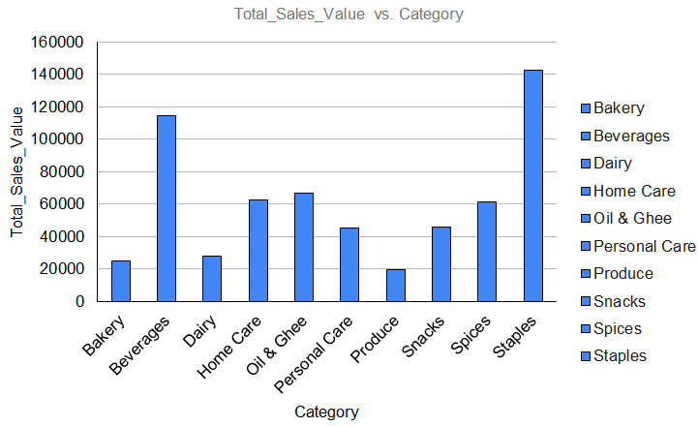
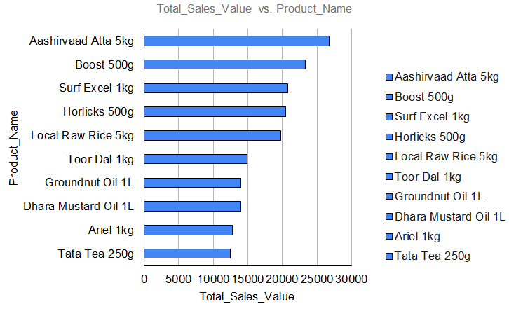
KEY INSIGHTS AND RECOMANDATIONS
Insight : Staples and Beverages
Contribute the highest revenue,
while some categories remain
underutilized.
Recommendation : Use cross-selling
and bundled offers to increase sales of low-contribution categories.
Insight : Revenue is highly dependent on a few core categories, increasing concentration risk.
Recommendation : Promote
moderate-performing categories
alongside staples to diversify
revenue sources.
Insight : A small number of products drive a large share of total revenue, indicating a concentrated sales mix.
Recommendation : Leverage
top-selling products to cross-sell mid-tier items through targeted promotions.

Slide 7
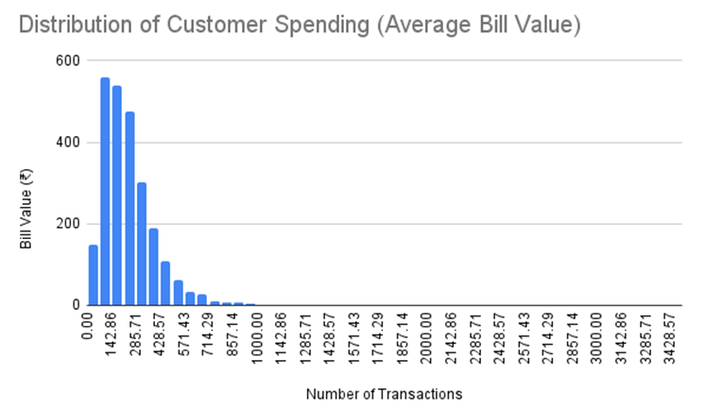
KEY INSIGHTS AND RECOMANDATIONS
Insight :Most transactions cluster around ₹200–₹350 with a right-skewed distribution, indicating frequent, small, need-based purchases and limited bulk buying..
Recommendation :Introduce combo offers and multi-buy promotions to gradually increase the average bill value from ~₹300 to ~₹400 without expanding the customer base.

Slide 8
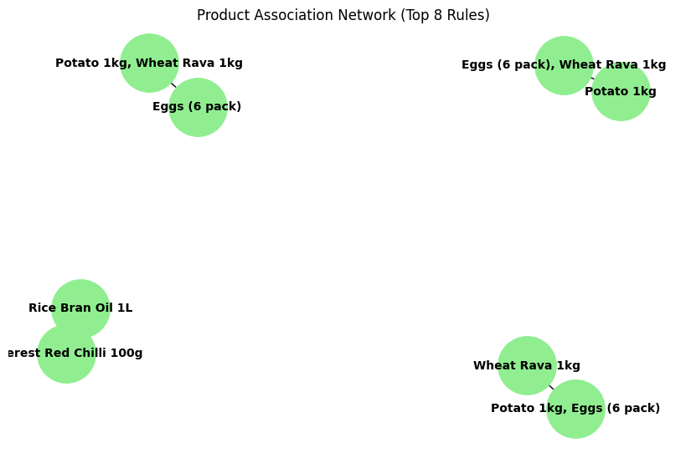
KEY INSIGHTS AND RECOMANDATIONS
Insight :The network shows strong and consistent co-purchasing patterns among essential grocery items, indicating routine, need-based buying behavior. High lift values reflect predictable customer preferences at Nana Grocery Store.
Recommendation :The store should bundle strongly associated products and place them nearby to increase basket value. Targeted combo offers on these items can further drive repeat purchases and sales.

Slide 9
RESULTS AND RECOMMENDATIONS
Key Insights:
  Sales follow predictable time-based patterns with peaks during salary weeks, weekends,
  and morning/evening hours
  Staples and Beverages dominate revenue; customers prefer low-cost essentials
  Strong co-purchase behavior indicates habitual, need-based buying
Key Recommendations:
  Ensure full stock during 6–9 AM & 6–9 PM peak hours
  Introduce MBA-based combo offers to increase basket value
  Optimize shelf placement using co-purchase patterns
  Use time-based promotions to boost slow-hour sales
  Expected Impact:
  Reduced stock outs and improved availability
  Higher average bill value and stable revenue
  Data-driven decision making without added costs

Slide 10
BDM PROJECT:
https://drive.google.com/drive/folders/1Ax8Q9RHwVAS0eGoOGje6G8FDkiWZYp00?usp=sharing

